Slide 1


library(dplyr)
rladies_global %>% filter(city == 'Bari')
Manipolare i dati con
Tidyverse

Slide 2


Hello!
Welcome to R-Ladies Bari

Slide 3
1.
Introduction
R language, RStudio

Slide 4
Three things
you’ll need to install
Install R -- this is the open-source programming language we’ll use (download via CRAN -- Comprehensive R Archive Network)
Install RStudio -- this is the most popular IDE for R and will make your life a lot easier (download from rstudio.com/download)
Install the tidyverse -- this is the group of packages we’ll use within R to work with data. Install with one line of code in R: install.packages(“tidyverse”)

Slide 5

2.
Manipolare i dati con Tidyverse

Slide 6
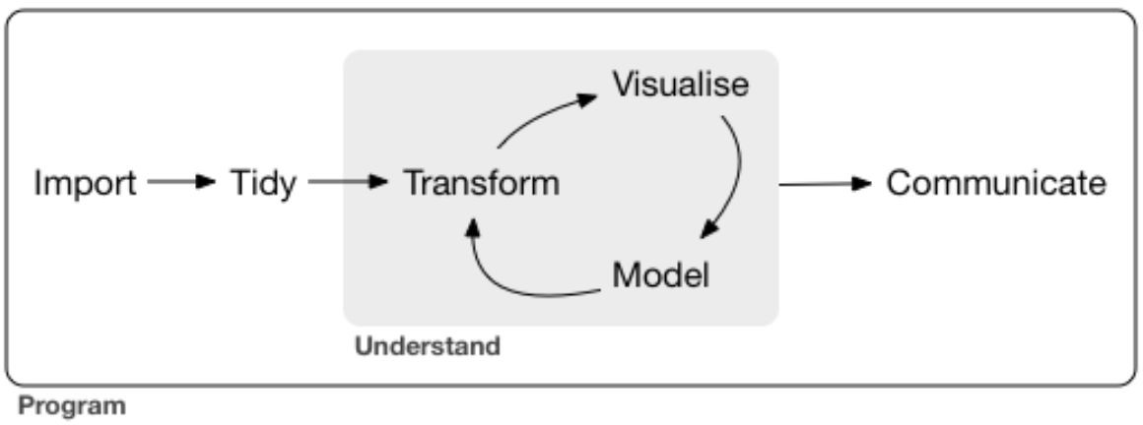
The data science process (tidied)

Slide 7
What is
the tidyverse?
Collection of R packages based on tidy data principles
Designed to work together
An easier way to code!
AKA “Hadleyverse” (most packages written by Hadley Wickham)

Slide 8
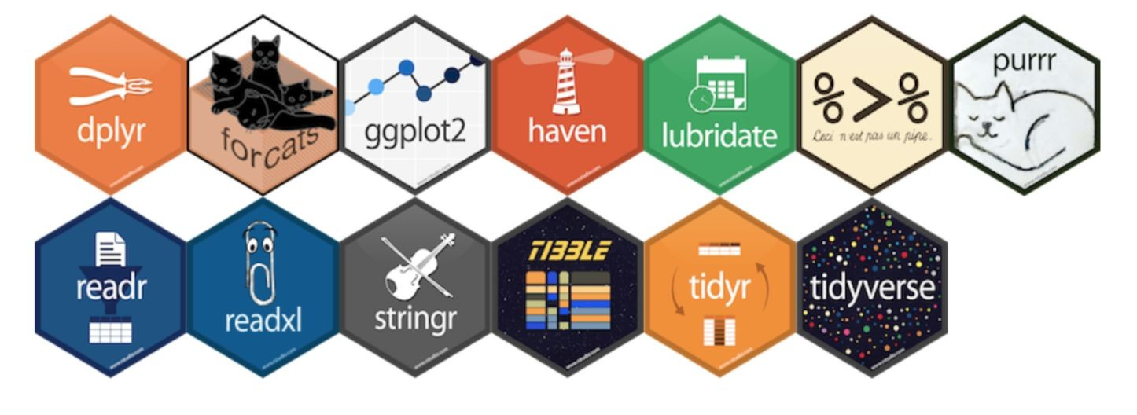
What is
the tidyverse?

Slide 9
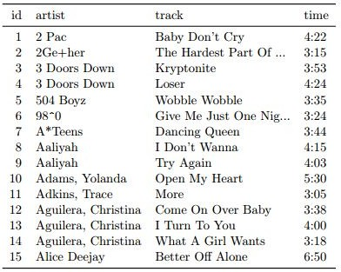
What is tidy data?
Each variable is a column
Each observation is a row
Each type of observational unit is a table

Slide 10

3.
dplyr
Let’s start with the first set of slides

Slide 11
What is dplyr?
Grammar of data manipulation:
+ mutate() to create new variables from existing ones
+ select() picks variables based on their names
+ filter() allows pointed selection based on given criteria
+ summarise() reduces multiple values down to a single summary
+ arrange() changes the ordering of rows
+ group_by() performs any of the above on a group-by-group basis

Slide 12
dplyr syntax
+ All calls to dplyr verbs follow the same format:
The first argument is a dataframe
The subsequent arguments describe what to do to that dataframe, using unquoted variable names.
+ Each call returns a new dataframe (rather than overwriting the ‘old’ one)
+ Example:
filter(dataset_name, name == “Francesca”)

Slide 13
What is magrittr?
Simplifying R code with pipes (%>%)
+ Easy way to pass data through functions without nesting
+ First argument of each function is “piped” in to reduce redundancy

Slide 14
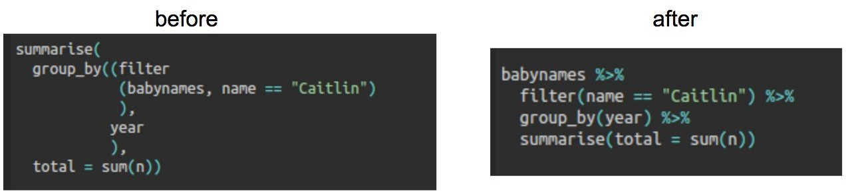
dplyr + magrittr example

Slide 15
What is dplyr?
Grammar of data manipulation:
+ select() picks variables based on their names
+ arrange() changes the ordering of rows
+ filter() allows pointed selection based on given criteria
+ mutate() to create new variables from existing ones
+ summarise() reduces multiple values down to a single summary
+ group_by() performs any of the above on a group-by-group basis

Slide 16

Quick aside: iris dataset
+ Included in R (iris to view)
+ 150 observations of 5 variables:
Iris type, sepal length + width, and petal length + width

Slide 17
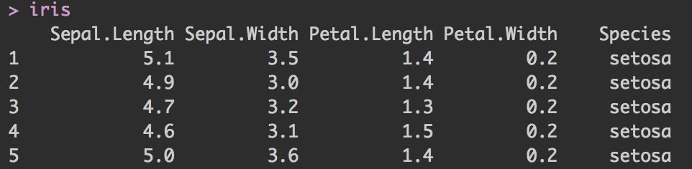
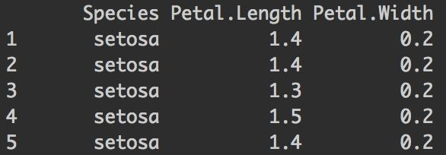
select()
+ Picks variables based on their names
+ First argument is dataframe; subsequent arguments represent columns to select
iris %>% select(Species, Petal.Length, Petal.Width)

Slide 18
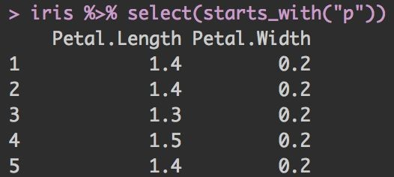
select() + helper functions
Helper functions you can use within select():
+ starts_with(“a”) matches names that begin with “a”
+ ends_with(“z”) matches names that begin with “z”
+ contains(“lady”) matches names that contain “lady”
+ matches(<regex>) allows you to do regex matching on names

Slide 19
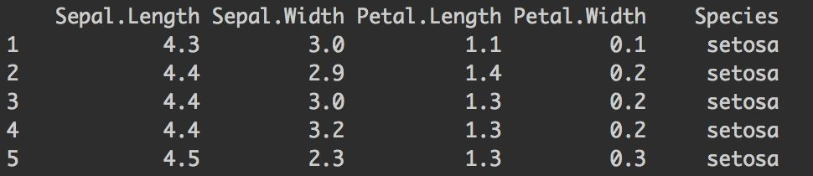
arrange()
+ Changes the ordering of rows
+ First argument is the dataframe, subsequent arguments are columns and/or expressions used to re-arrange the dataframe
+ Note: default is ascending order, and NA’s are always at the end
iris %>% arrange(Sepal.Length, Sepal.Width)

Slide 20
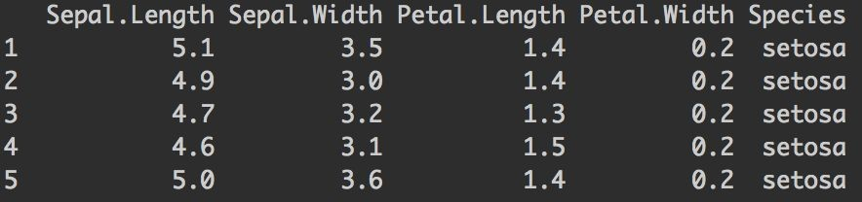
filter()
+ Allows pointed selection based on given criteria
+ First argument is the dataframe, subsequent arguments are expressions used to filter the dataframe
iris %>% filter(Species == “setosa”)
nrow = 150
nrow = 50

Slide 21
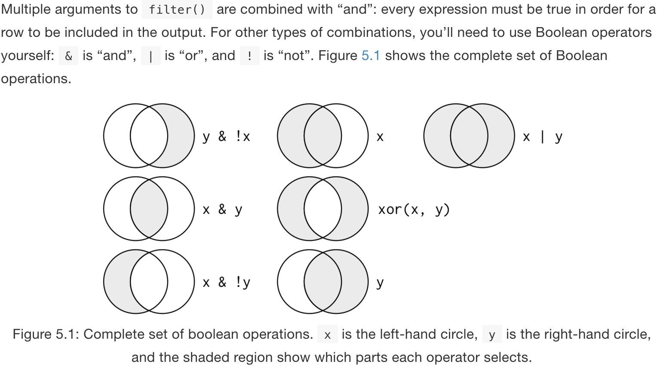
filter() + booleans

Slide 22
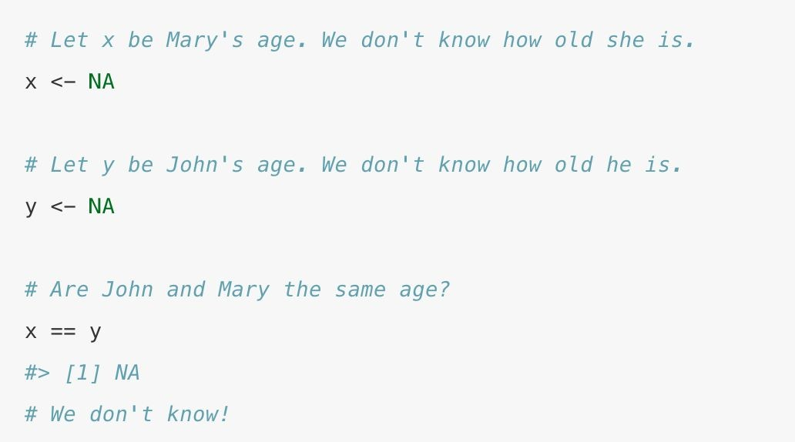
Quick aside: Missing values
+ NA represents a missing (unknown) value
+ Comparisons involve unknown values typically result in unknown values
+ To see whether a value is missing, use is.na()
+ filter() only includes rows where the condition is true (not false or NA)

Slide 23
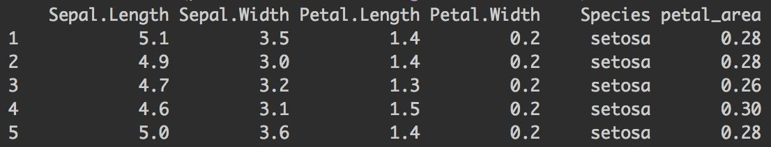
mutate()
+ Creates new variables from existing ones
+ Note: columns created with mutate() are always added to end of dataset
iris %>% mutate(petal_area = Petal.Length * Petal.Width)

Slide 24
mutate()
Useful functions
+ Arithmetic operators (+, -, *, /, ^)
+ Log functions (like log10())
+ Offsets like lead() and lag()
+ Logical comparisons (<, <=, >, >=, !=)
+ Ifelse statements (if this, then this, else this)
+ Cumulative and rolling aggregates
+ Ranking (like ntile())

Slide 25
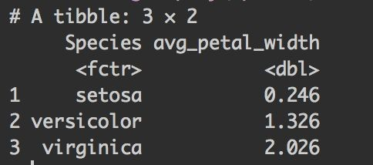
group_by() and
summarise()
+ group_by applies dplyr verbs by group
+ summarise reduces multiple values down to a single summary
iris %>%
group_by(Species) %>% summarise(avg_petal_width = mean(Petal.Width)

Slide 26
summarise()
Useful functions
+ Counts (n(), n_distinct())
+ Measures of location (mean(), median())
+ Measures of spread (sd(), IQR())
+ Measures of position (first(), last())

Slide 27
Tips & Tricks
+ If you don’t have the result of a dplyr chain to a dataframe, it will print
+ If you want to print and save, wrap assignment in parenthesis
+ Example: (iris_names <- iris %>% filter(Species == “setosa”))
+ rename() is a cool function to clean up messy column names
+ After grouping with group_by(), you can ungroup() to remove groupings
+ There is a cheat sheet for data wrangling!

Slide 28
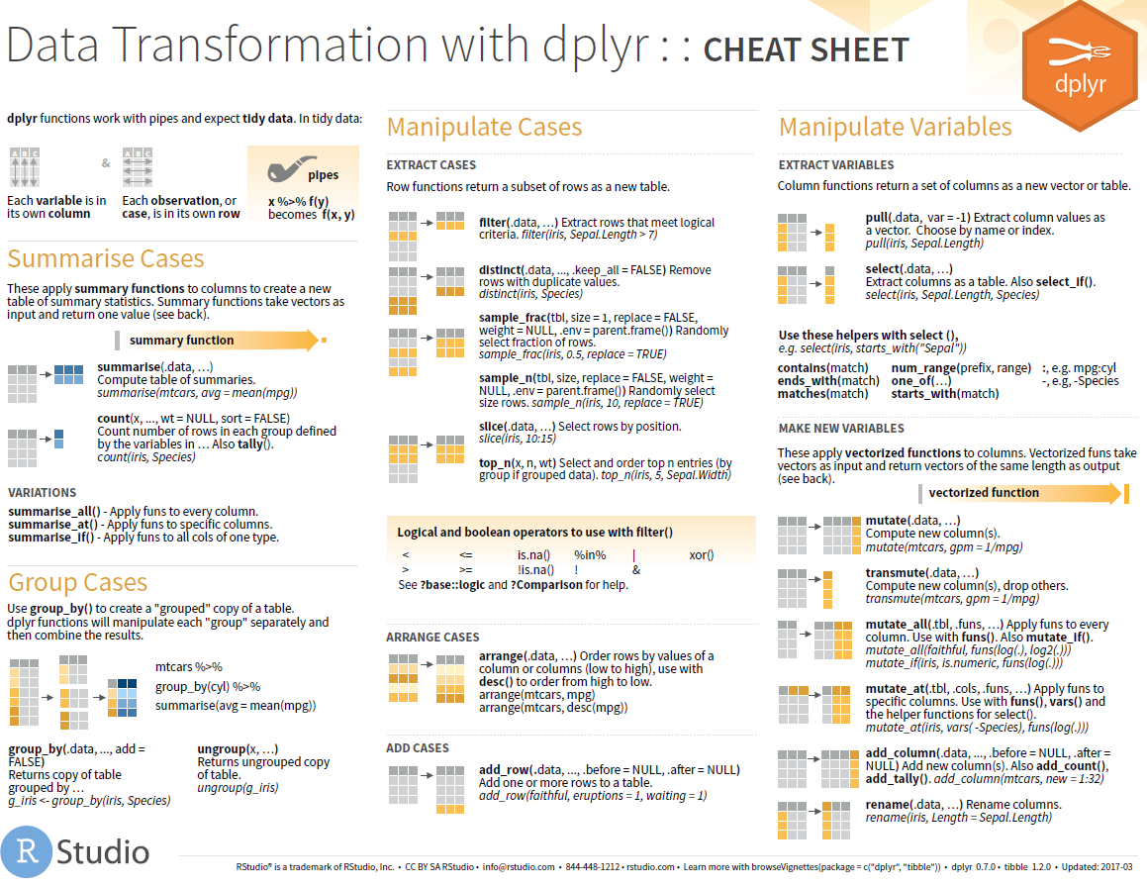
Cheat sheet for data wrangling

Slide 29
4.
Wrap-up
Announcements, upcoming events, etc.

Slide 30
R-Ladies Bari Upcoming Events

